Slide 1

Software Engineering New and Old Book Purchase System(Book Wala)
Under the guidance of
Dr. Sheikh Fahad Ahmad

Slide 2
Team Members
UID | Name
2110030031 | Sumeet Sharma
2110030109 | D. Harshavardhan Reddy
2110030190 | K. Sai Vardhan Reddy
2110030252 | Mohammed Afeef Sayeed

Slide 3

Objective
The Main Objective of this project is to create an Online Book Shop That Allows user that allows to search and purchase a book online based category, author and subject.
(Based on Bookstore Management System)

Slide 4
What is Bookstore Management System?
Bookstore management system mainly focuses on the activities of a book store such as information on books and books sold to customers.
The database flexibility, convenient features, the maximum increase in customer service, access to accurate information make this ideal for all sizes of book stores.

Slide 5
Existing solutions/ Naïve solutions
https://link.springer.com/article/10.1023/A:1026076314992
https://timesofindia.indiatimes.com/life-style/books/features/heres-why-second-hand-books-are-losing-its-market/articleshow/53823611.cms\
(Pandemic and New Books available online)
https://core.ac.uk/download/pdf/301369506.pdf
(online bookstore effecting the traditional bookstores)

Slide 6
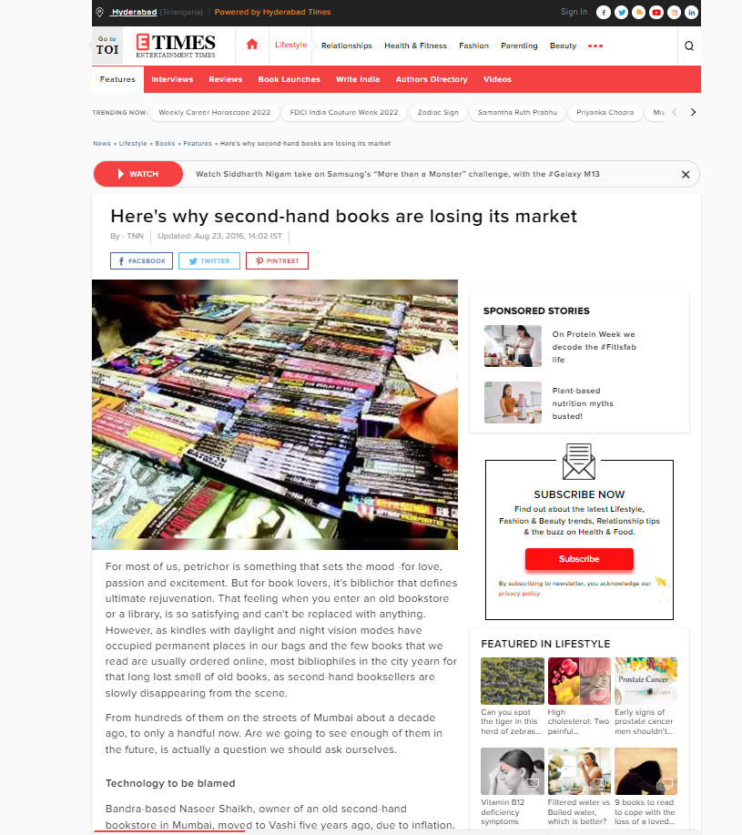
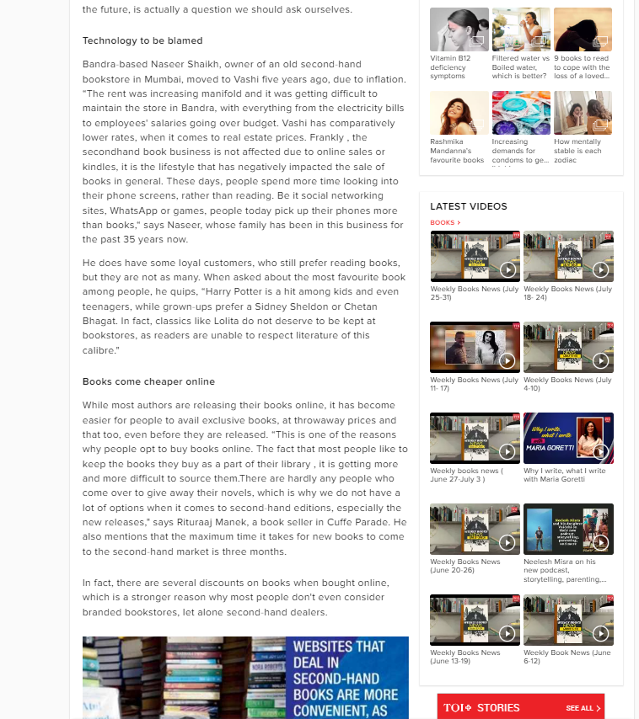
https://timesofindia.indiatimes.com/lifestyle/books/features/heres-why-second-hand-books-are-losing-its-market/articleshow/53823611.cms\

Slide 7
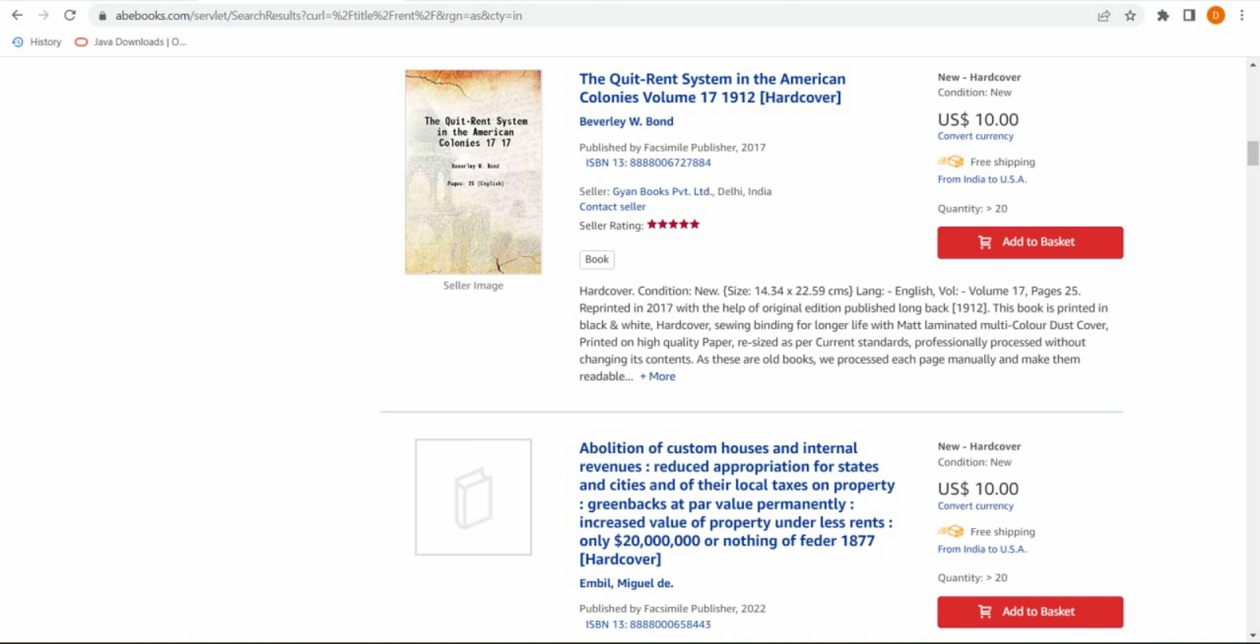
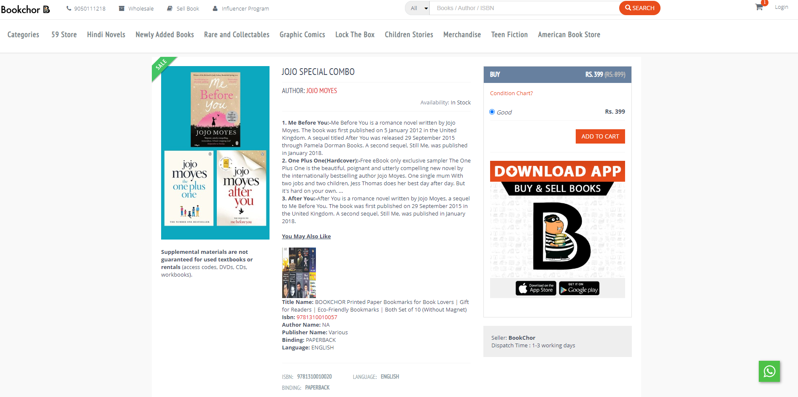
No Rent Option…
No Pay on Delivery Option…

Slide 8
Proposed System
It is the Automated Book Store Management System. Our Software user can add members, add books , search members, search books, update info, etc…
It provides “BETTER AND EFFICENT” services to members
Reduced The Workload for the Employees
Faster Access to the Information.
All details will be available in one click

Slide 9
Our Idea to Implement :
To Add Rent a Book option
Pay on Delivery Option
Giving Opportunities To the New Publishers.

Slide 10
Our Idea to Implement
To Add Rent a Book option
Pay on Delivery Option
Giving Opportunities To the New Publishers.

Slide 11
Proposed Algorithm Design Technique
Q . What is the technique?
->We are going to follow 5 generic activites
1.COMMUNICATION
2.PLANNING
3.MODELLING
4.CONSTRUCTION
5.DEPLOYMENT

Slide 12
Modules
Registration
Search The Book
Purchase The Book
Payment
Feedback

Slide 13
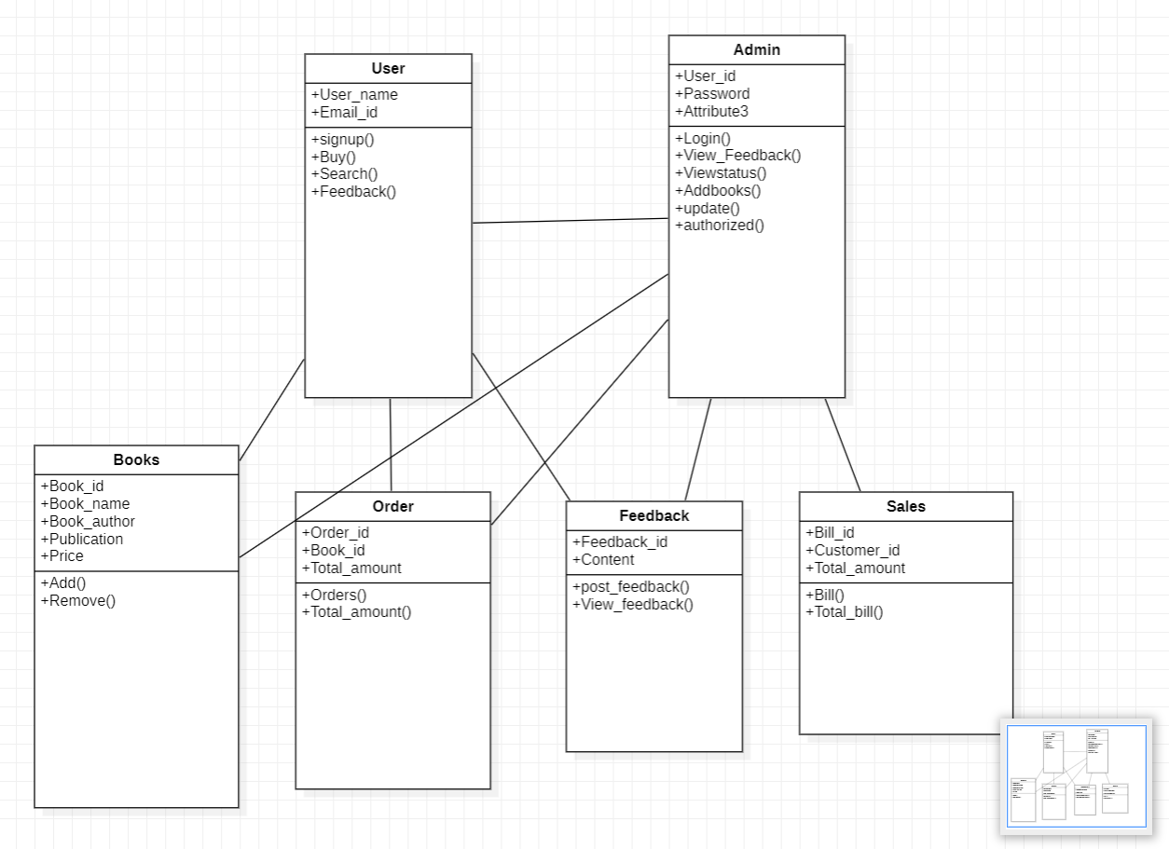
Class Diagram

Slide 14
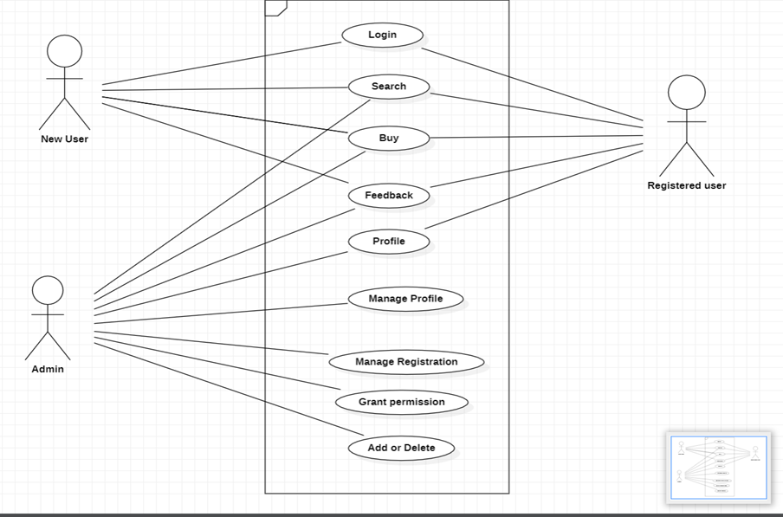
Use Case Diagram

Slide 15
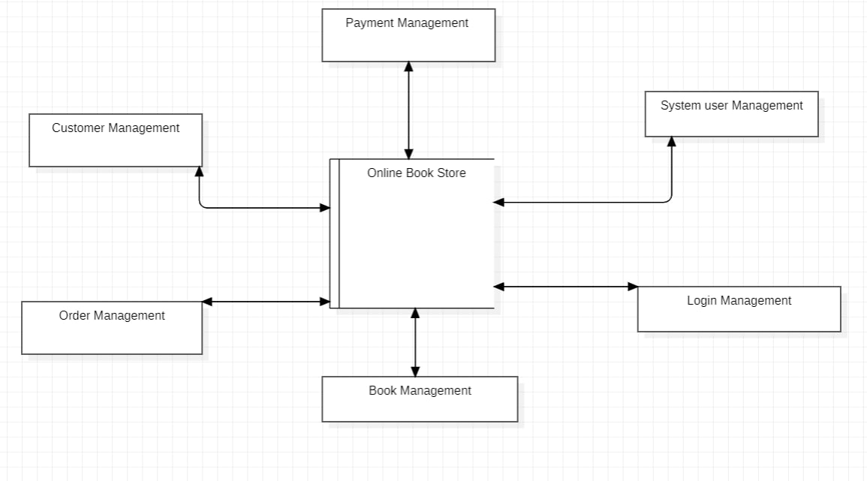
Data Flow Diagram

Slide 16



Data Structures needed
Tools:
StarUML
MySQl
Python
CSS
HTML

Slide 17

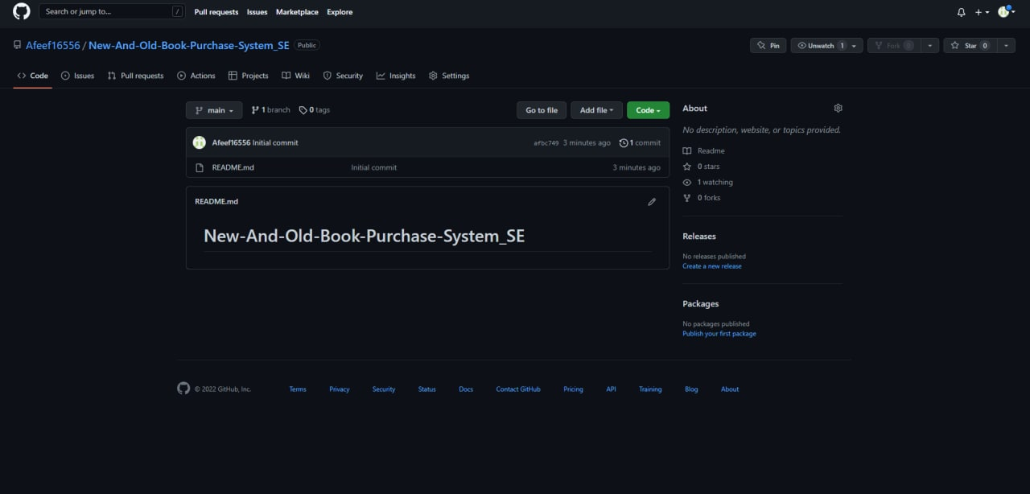
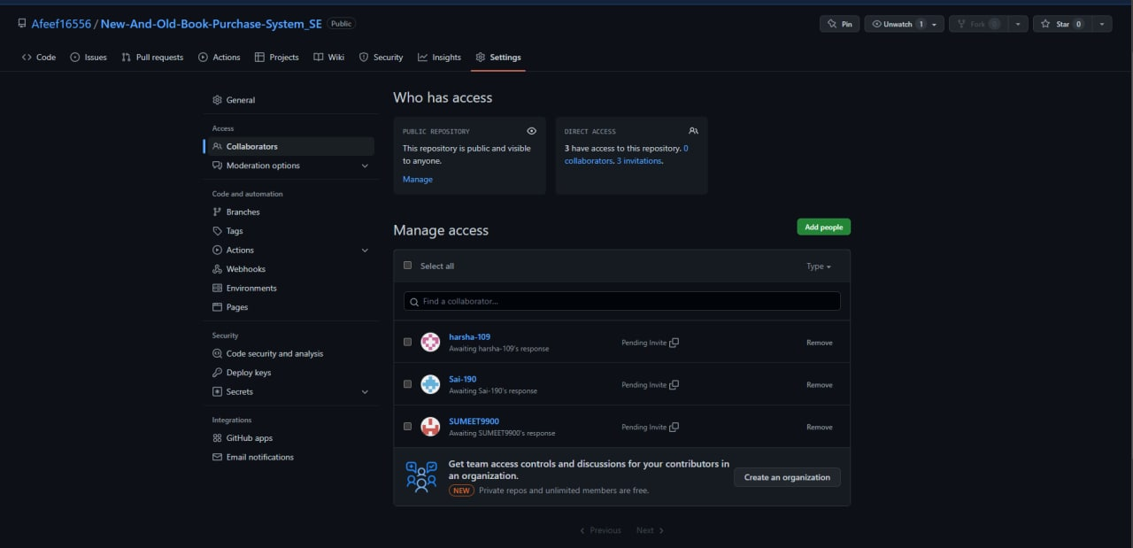
Github setup
https://github.com/Afeef16556/New-And-Old-Book-Purchase-System_SE

Slide 18
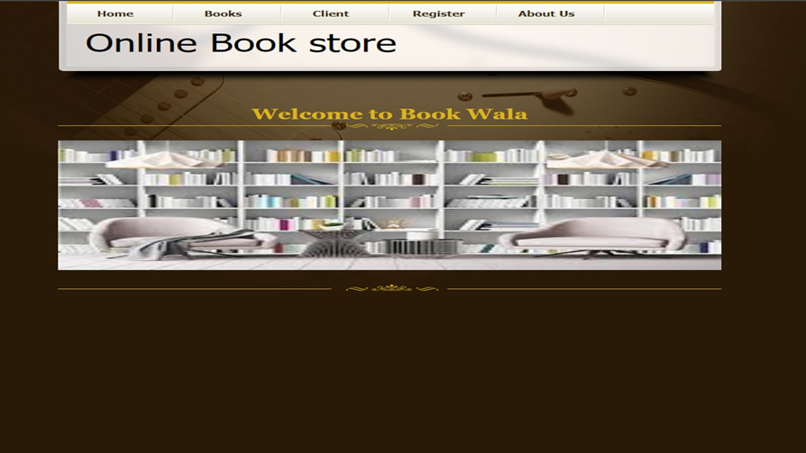
Sample Design for Webpage

Slide 19
Division of work among the group members
2110030031 - Web designing
2110030190 - Database creation
2110030109 - Database Modeling
2110030252 – Web page Modeling

Slide 20


